Slide 1

POWER BI: AN INTRODUCTION TO DATA VISUALIZATION AND ANALYTICS

Slide 2
INTRODUCTION
Power BI is a Data Visualization and Business Intelligence tool that converts data from different data sources to interactive dashboards and BI reports. Power BI suite provides multiple software, connector, and services - Power BI desktop, Power BI service based on Saas, and mobile Power BI apps available for different platforms. These set of services are used by business users to consume data and build BI reports.

Slide 3

WHAT IS POWER BI?
is a powerful business intelligence tool developed by Microsoft. It enables users to connect, transform, and visualize data from various sources in real-time. With its intuitive interface and extensive range of visualization options, Power BI empowers users to gain valuable insights and make data-driven decisions effortlessly.

Slide 4

DATA VISUALIZATION WITH POWER BI
Power BI excels in Its rich set of interactive charts, graphs, and maps allows users to present complex data in a visually compelling manner. With a simple drag-and-drop interface, you can create stunning visualizations that highlight trends, patterns, and outliers, making it easier to communicate insights effectively.

Slide 5

REAL-TIME DASHBOARDS AND REPORTS
Power BI offers and reports, allowing you to monitor your data and key performance indicators (KPIs) in real-time. With automatic data refresh and seamless integration with various data sources, you can have up-to-date insights at your ﬁngertips, empowering you to respond quickly to changing business conditions.

Slide 6
CONCLUSION
In conclusion, Power BI is a game-changer in the world of data visualization and analytics. Its intuitive interface, powerful capabilities, and real-time insights make it an indispensable tool for businesses of all sizes. By harnessing the power of Power BI, you can unlock the true potential of your data and drive data-informed decision-making across your organization.

Slide 7
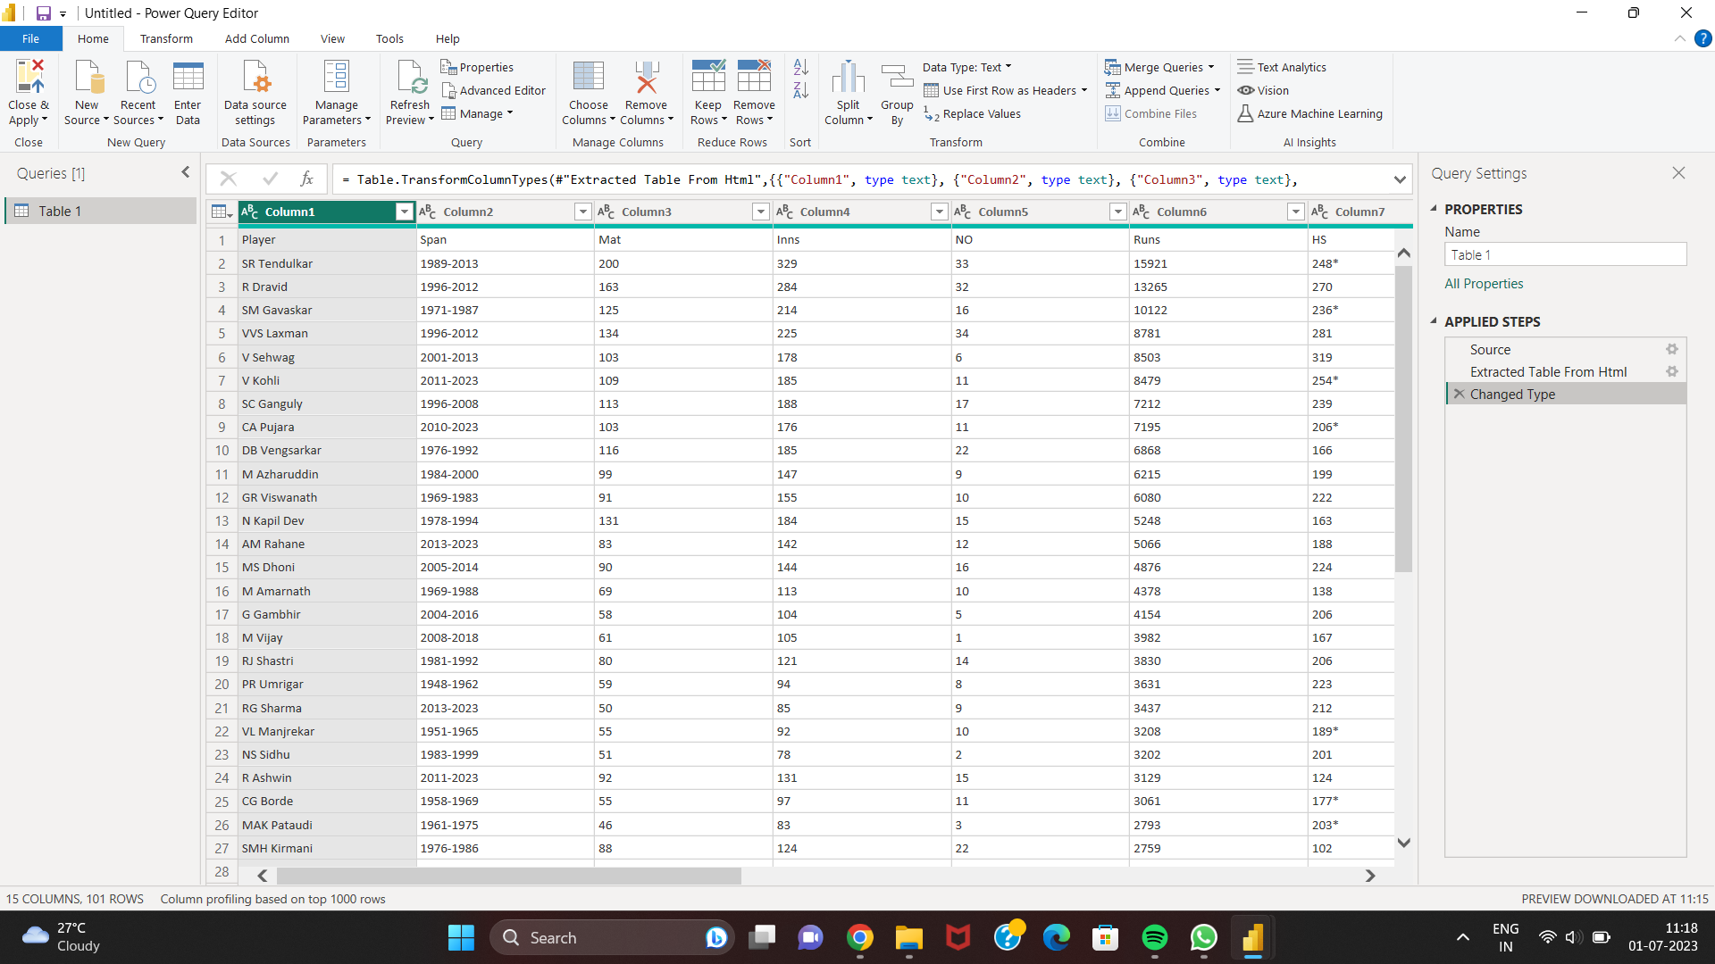
A. Test matches table:

Slide 8
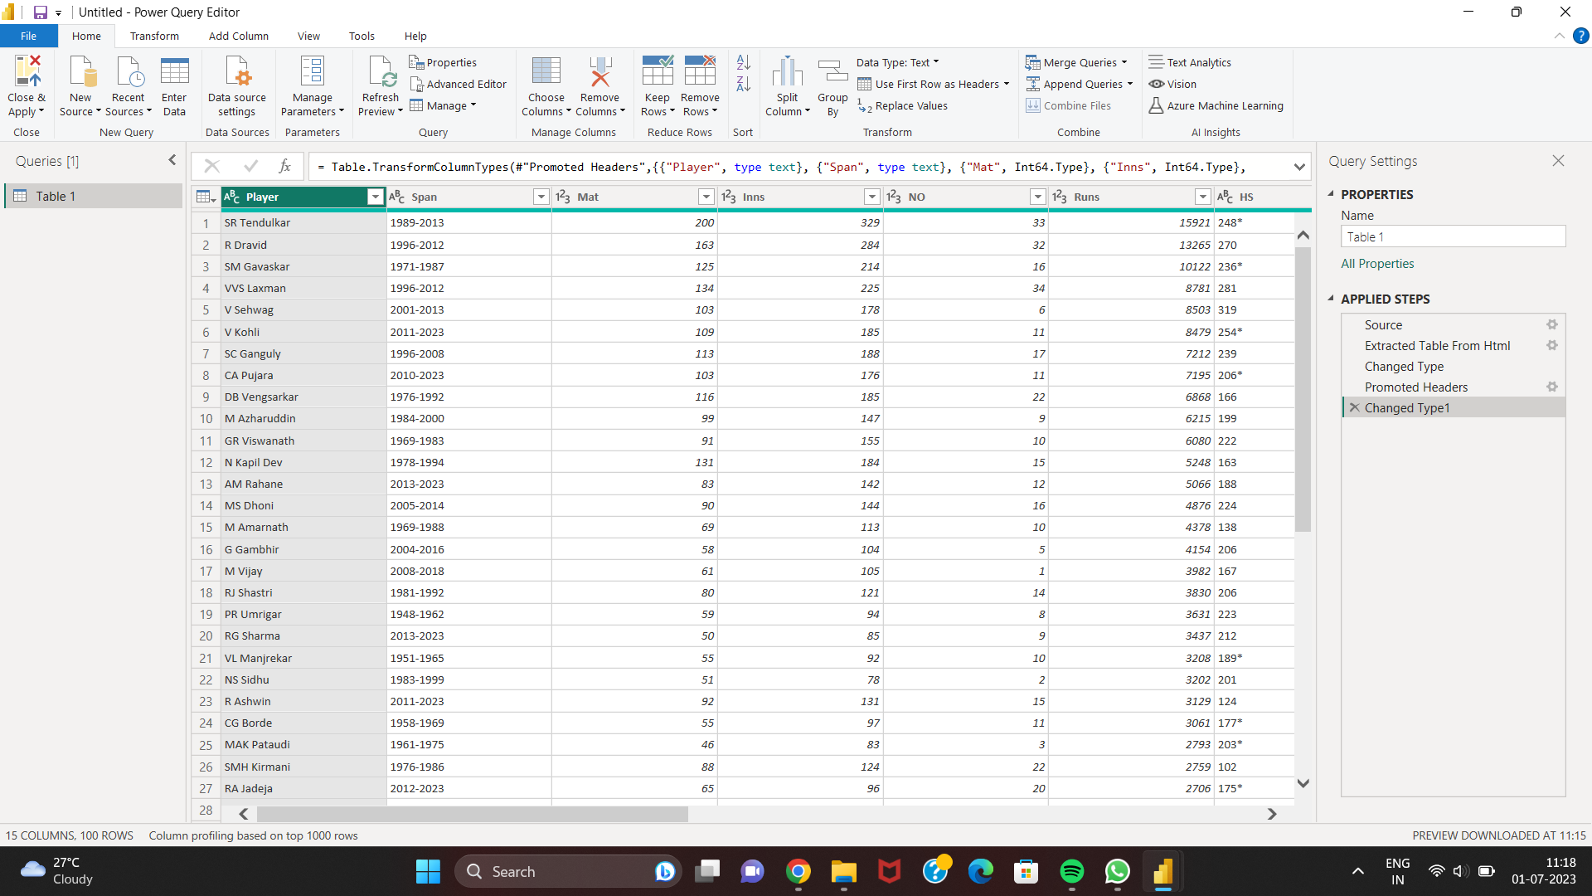
1) To change the column name select the option -> use First Row as Headers from Home tab.

Slide 9
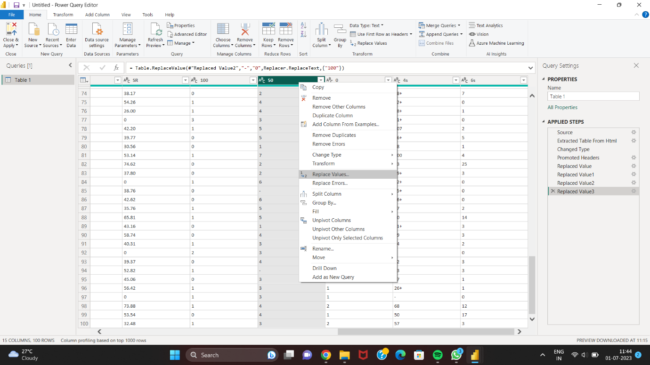
2) Relacing values – with 0.

Slide 10
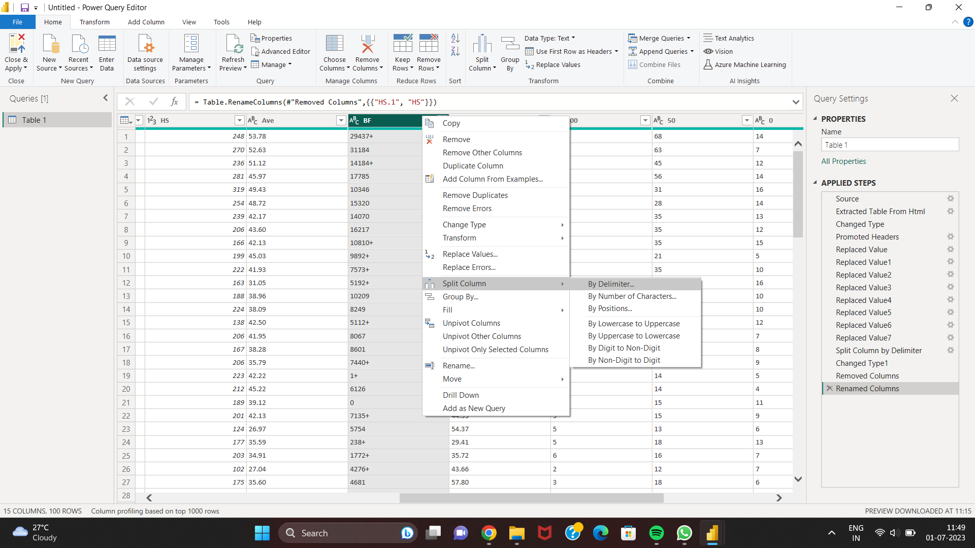
3) Split the + symbol from column.

Slide 11
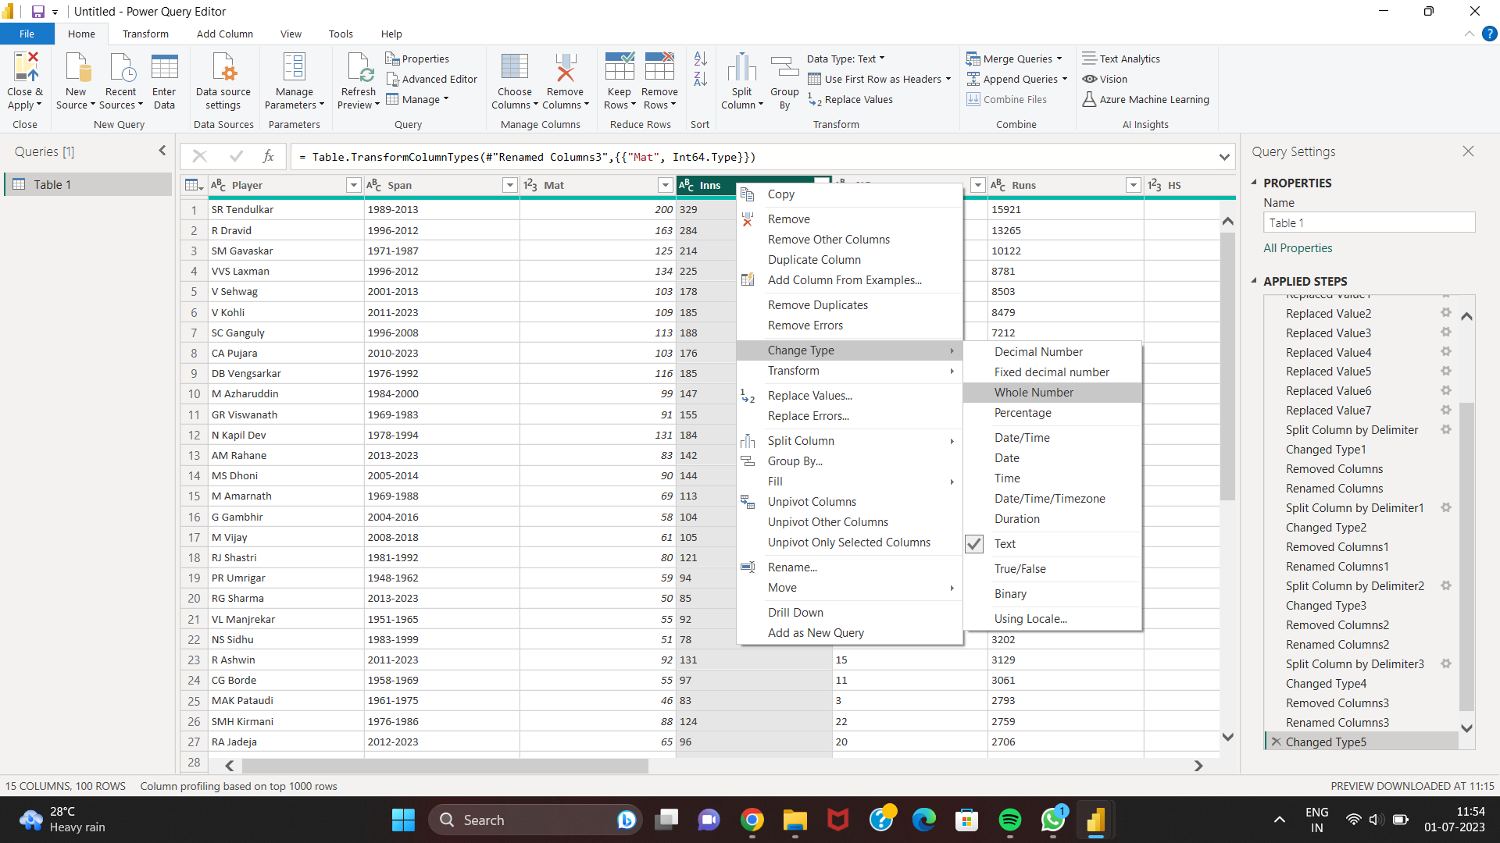
4) Change the data type.

Slide 12
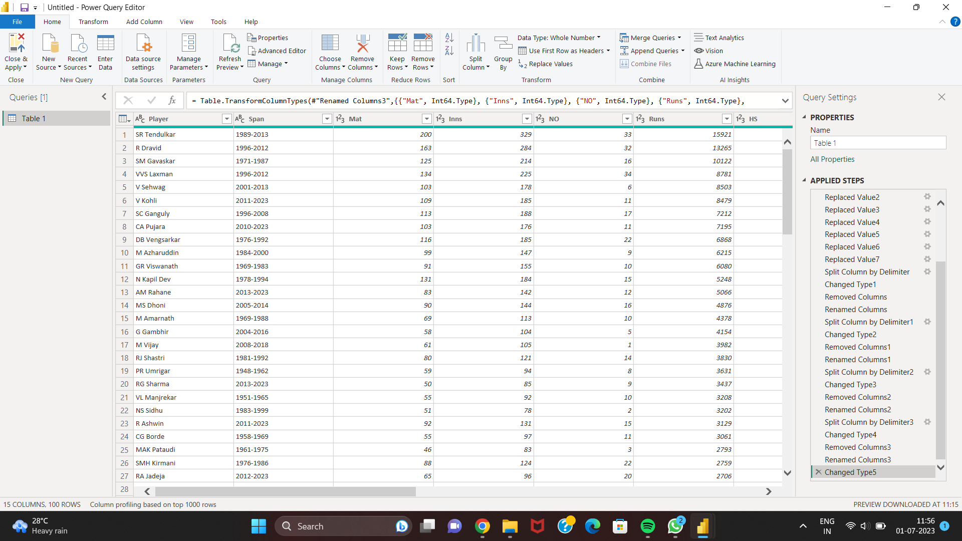
5) Cleaned data.

Slide 13
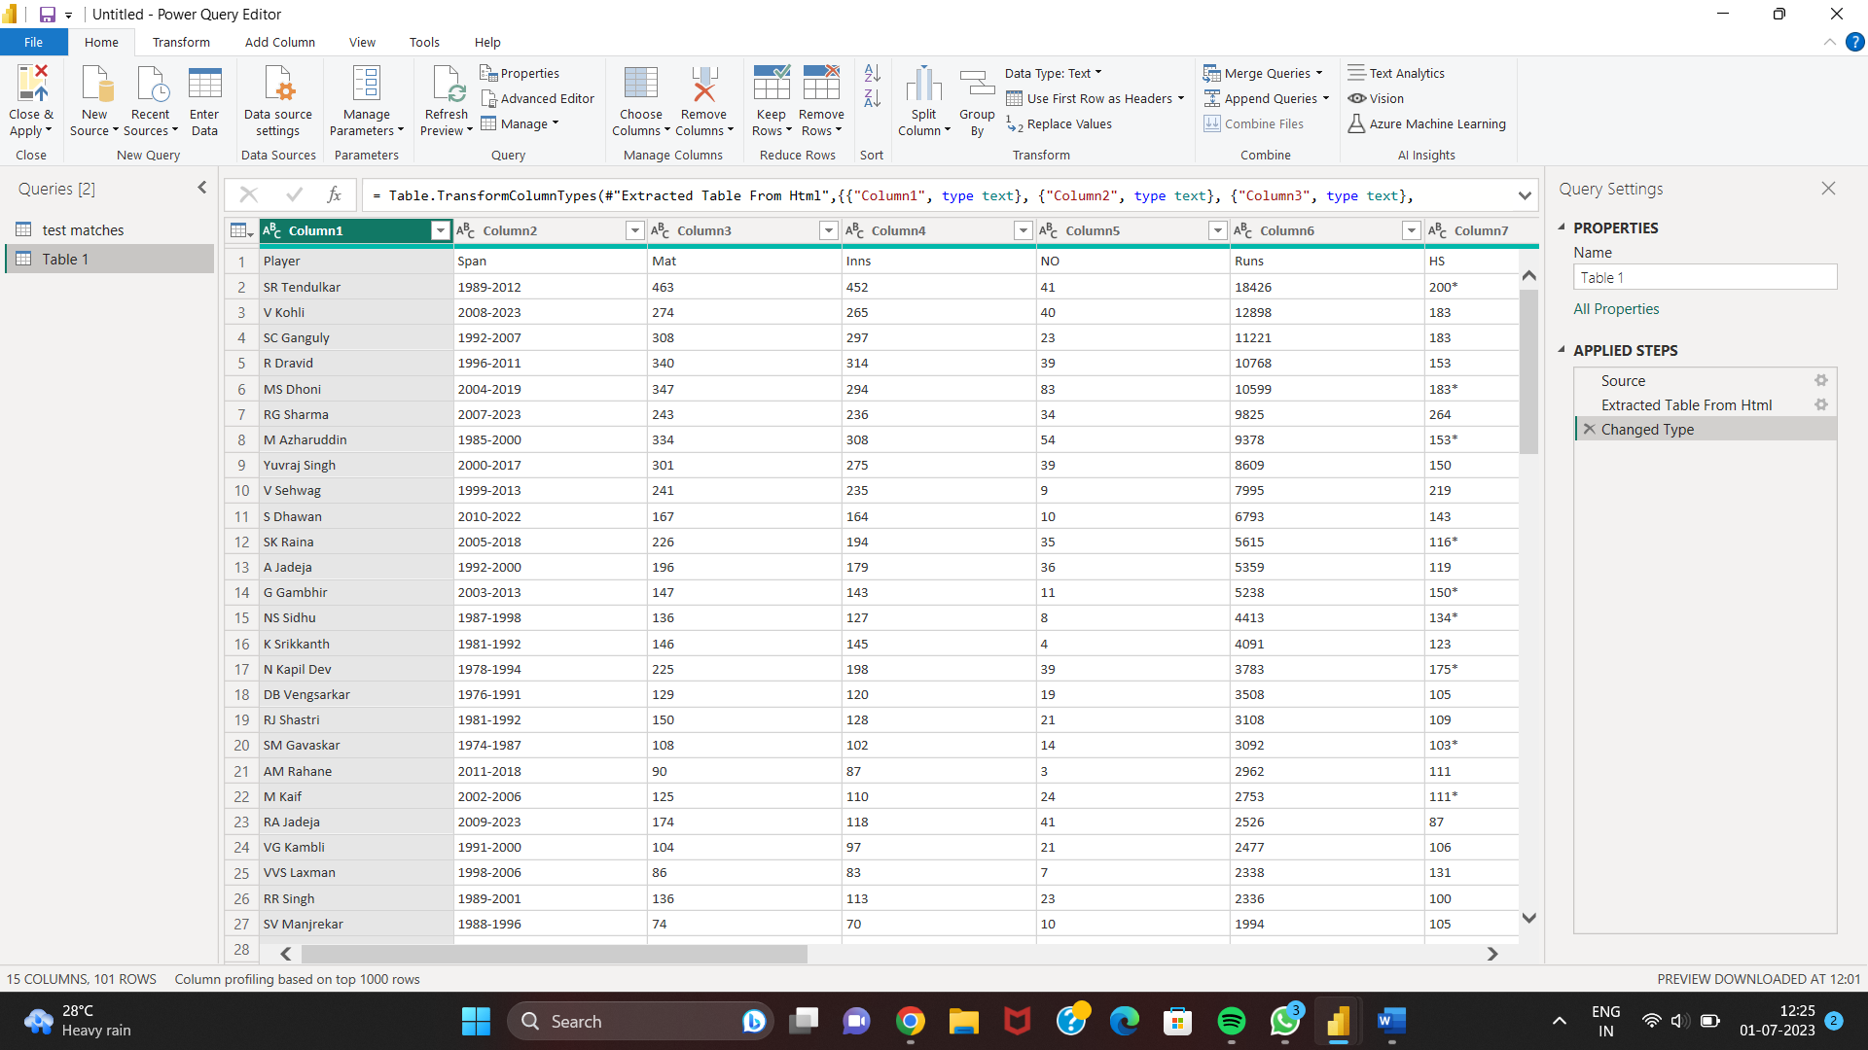
B. One day international table:

Slide 14
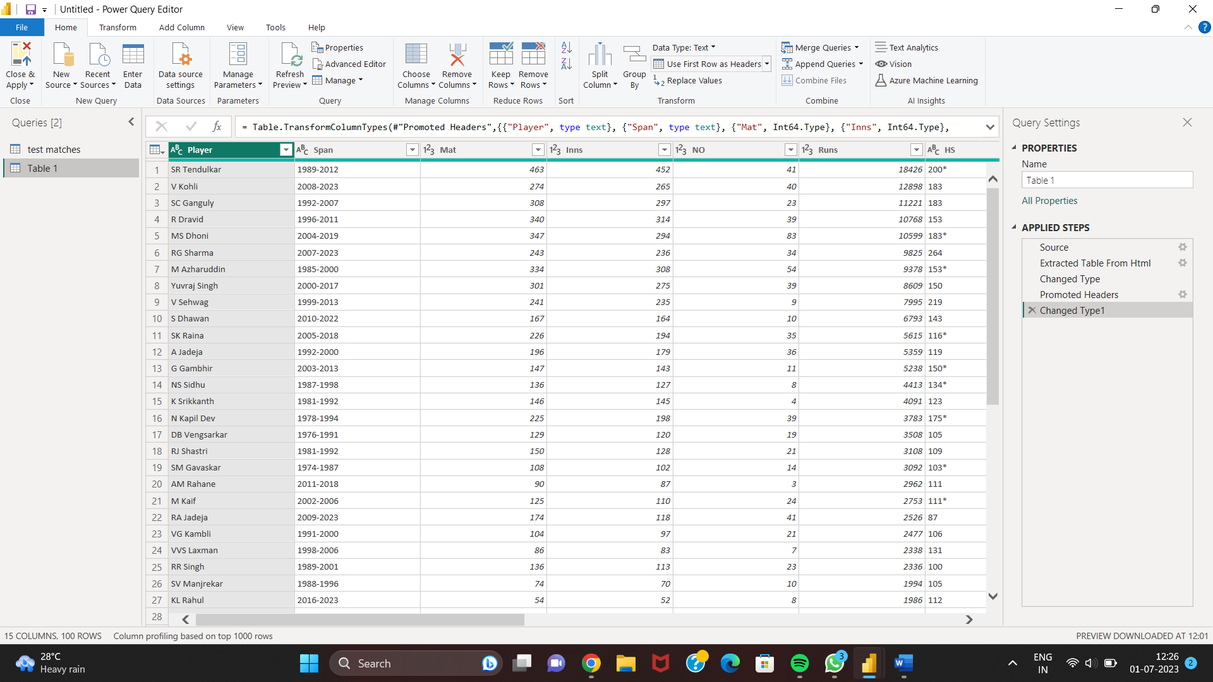
1) To change the column name select the option -> use First Row as Headers from Home tab.

Slide 15
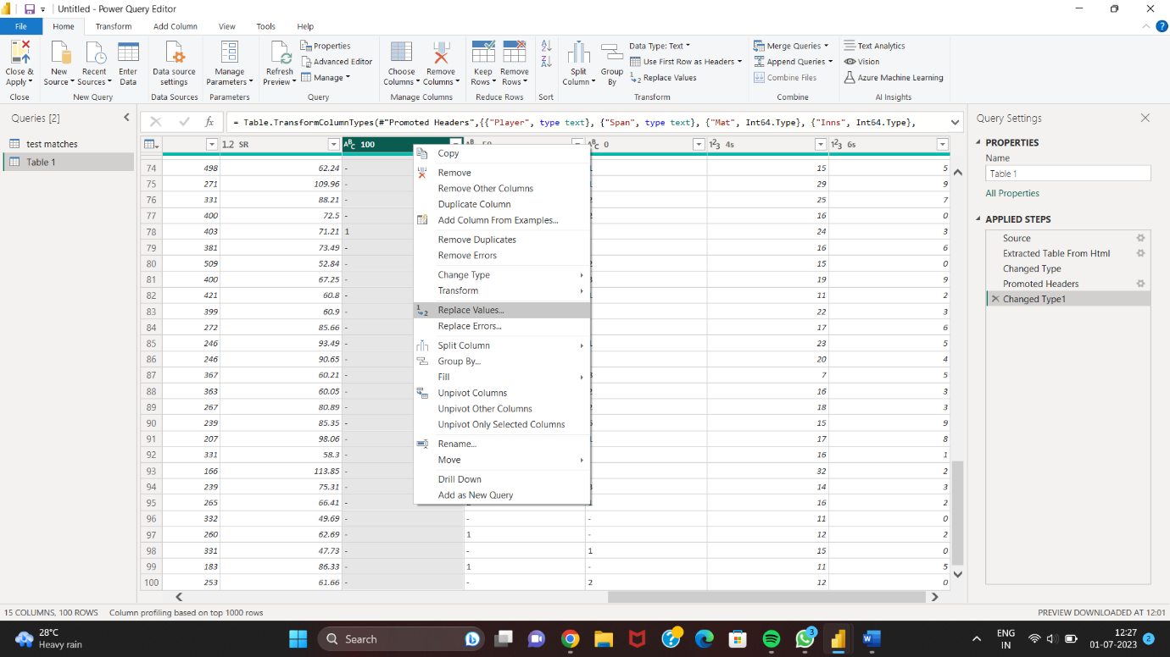
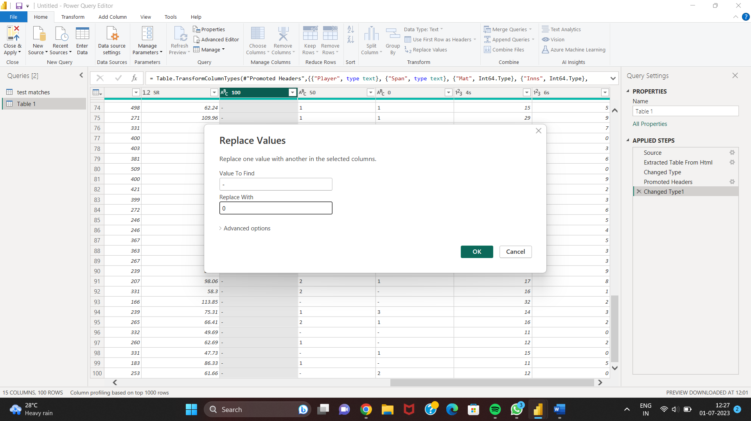
2) Relacing values – with 0.

Slide 16
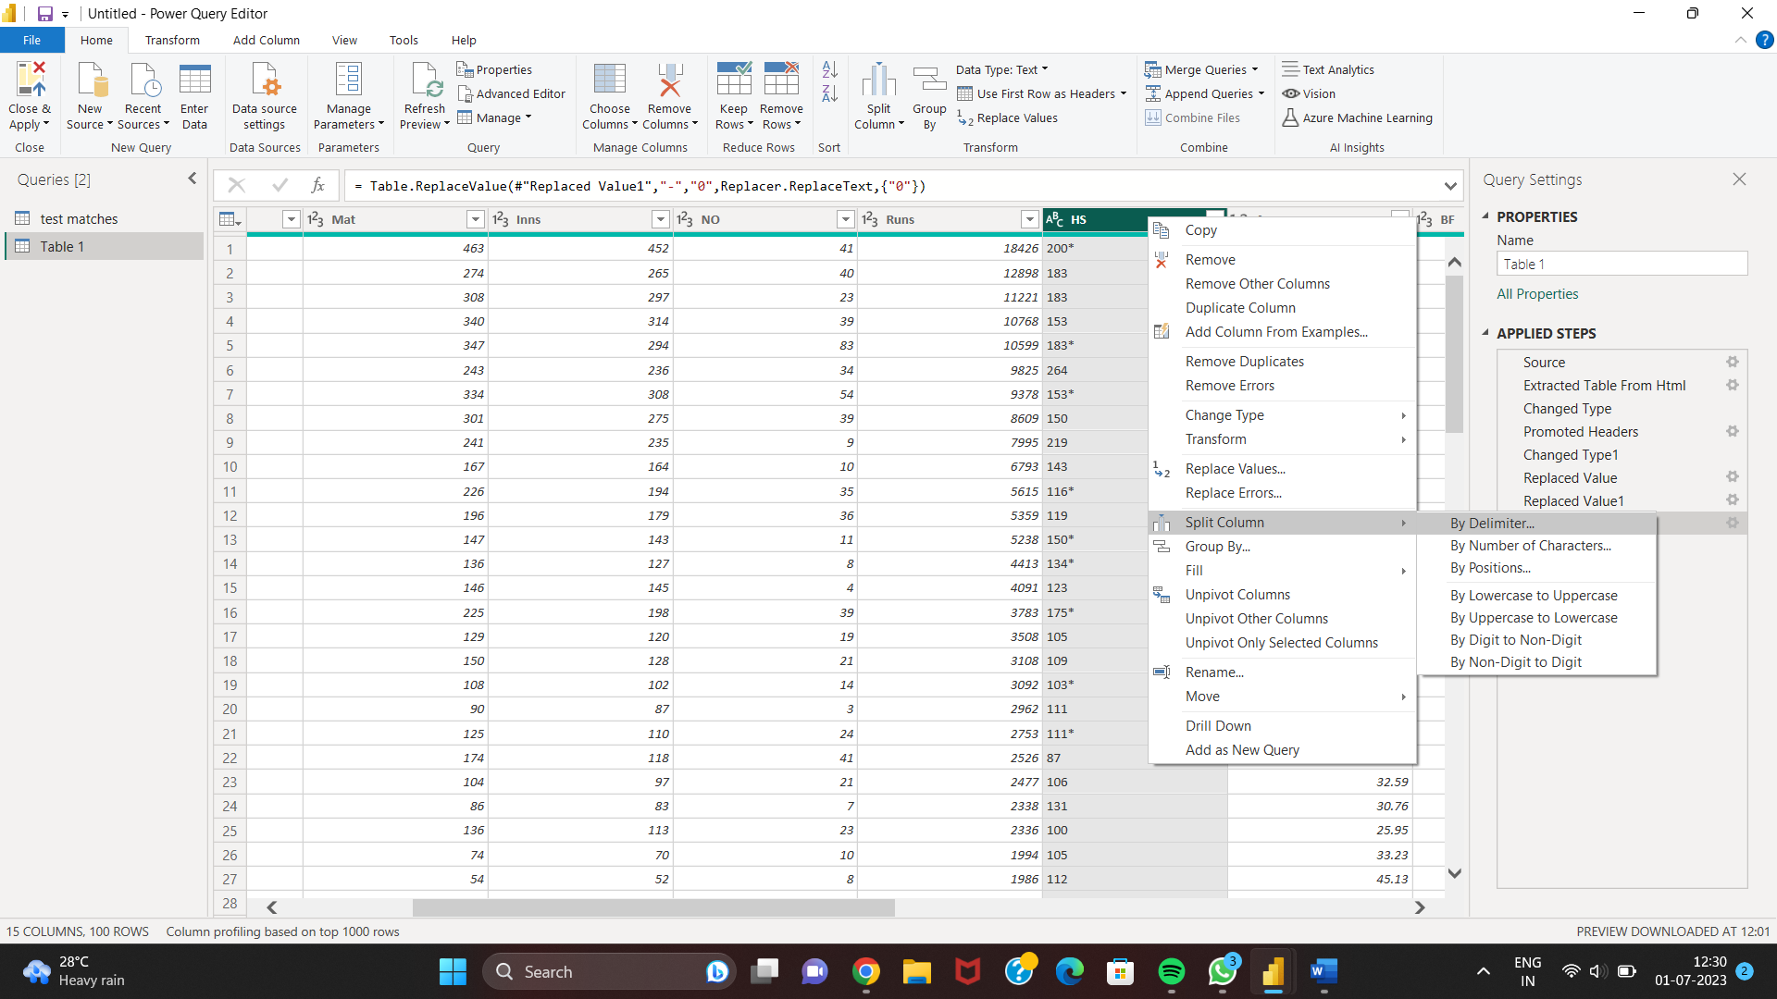
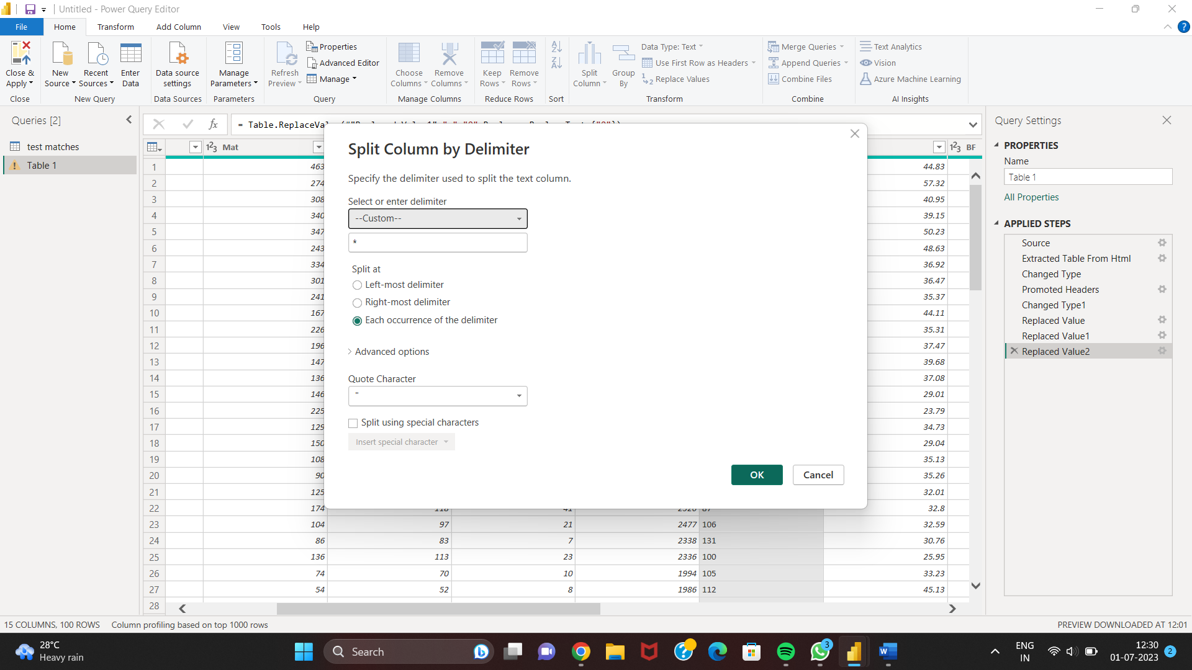
3) Split the * symbol from column.

Slide 17
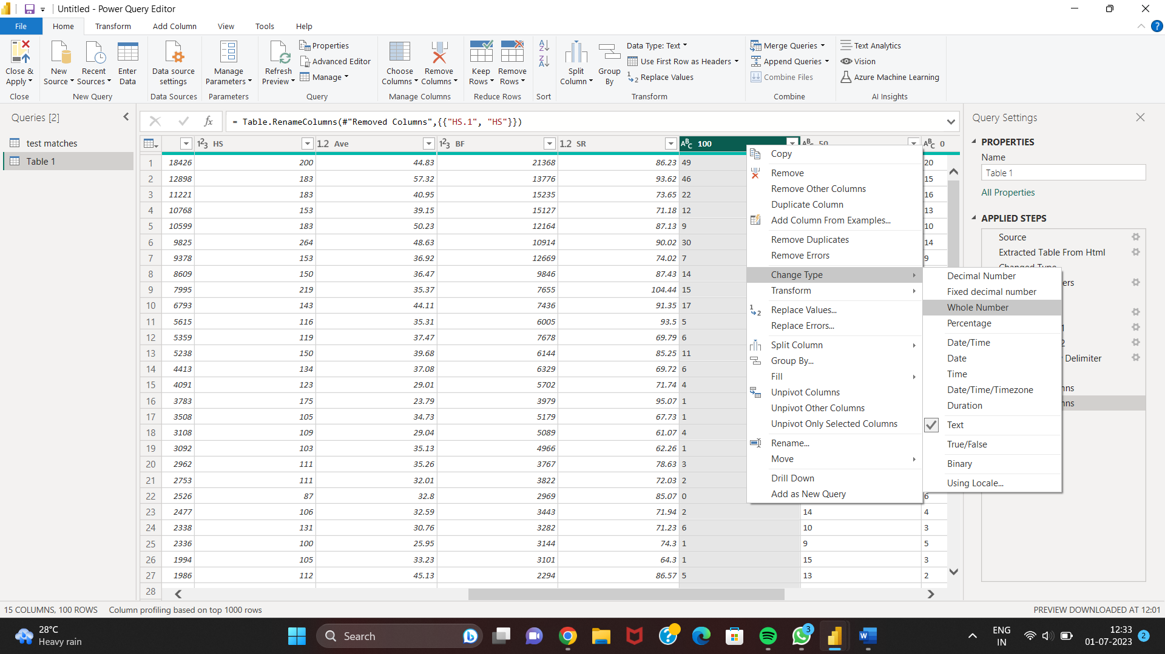
4) Change the data type.

Slide 18
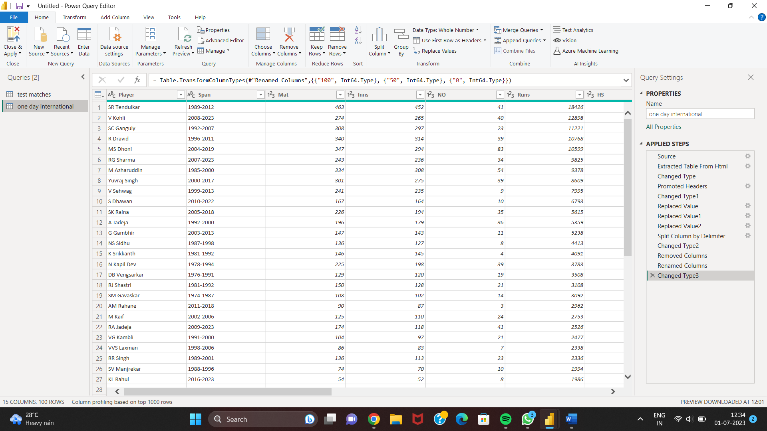
5) Cleaned data.

Slide 19
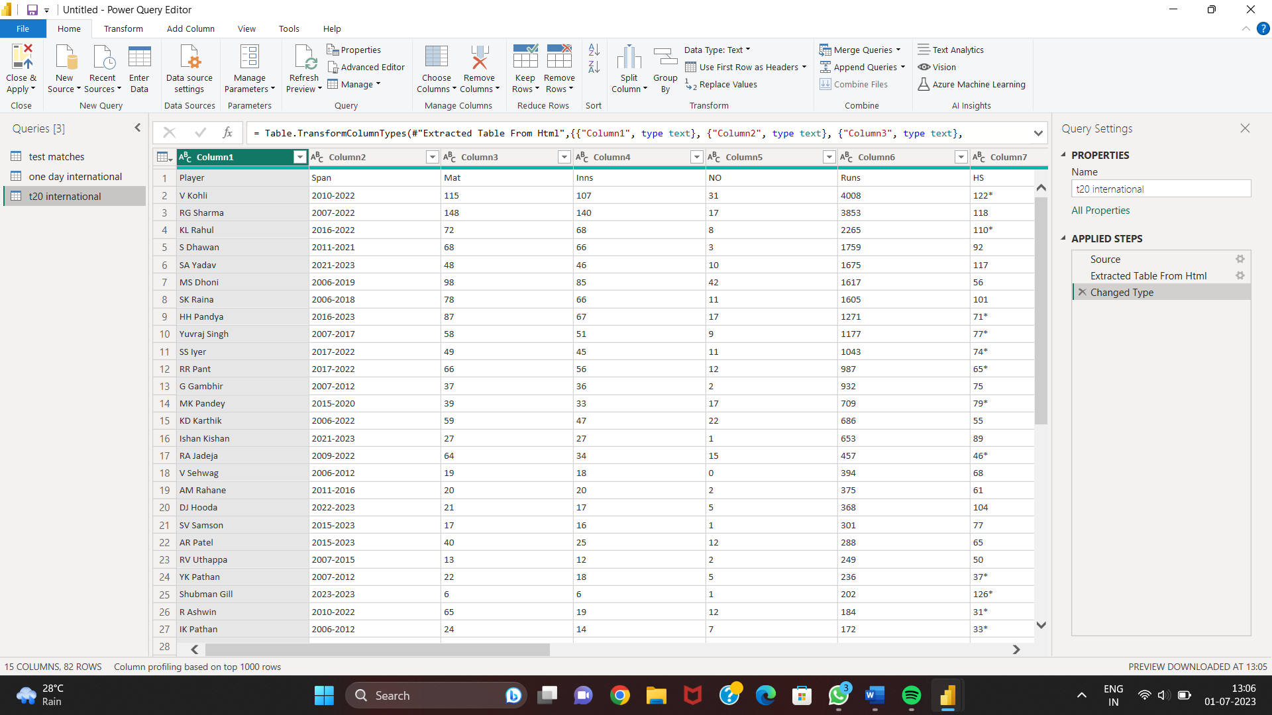
C. T20 international table:

Slide 20
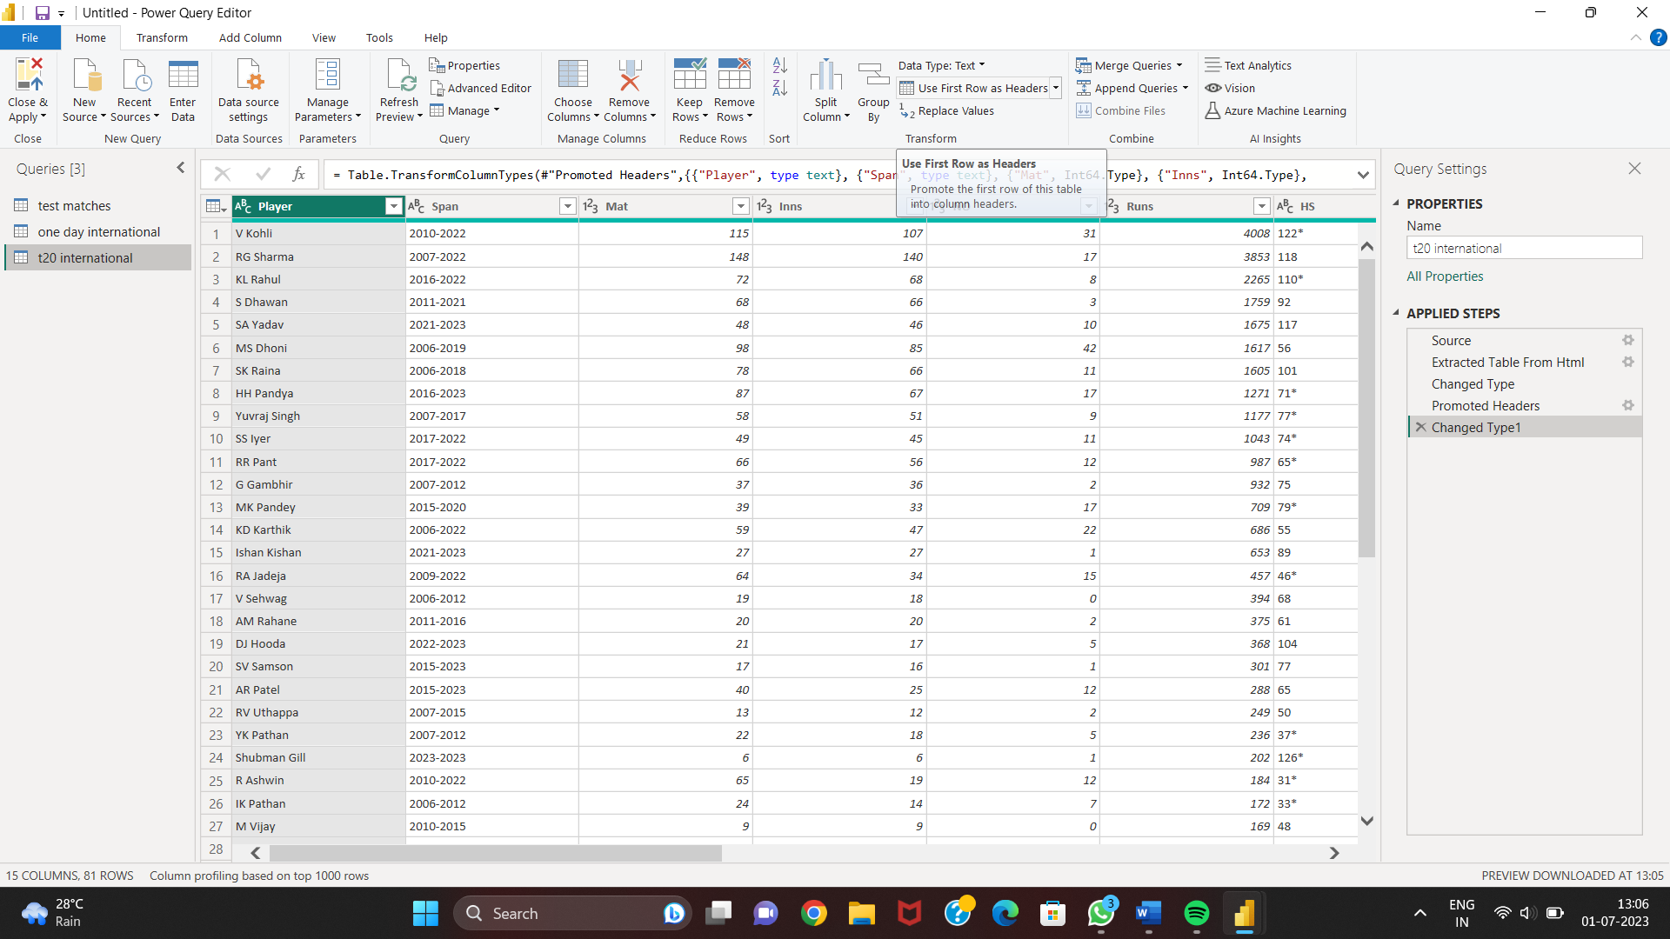
1) To change the column name select the option -> use First Row as Headers from Home tab.

Slide 21
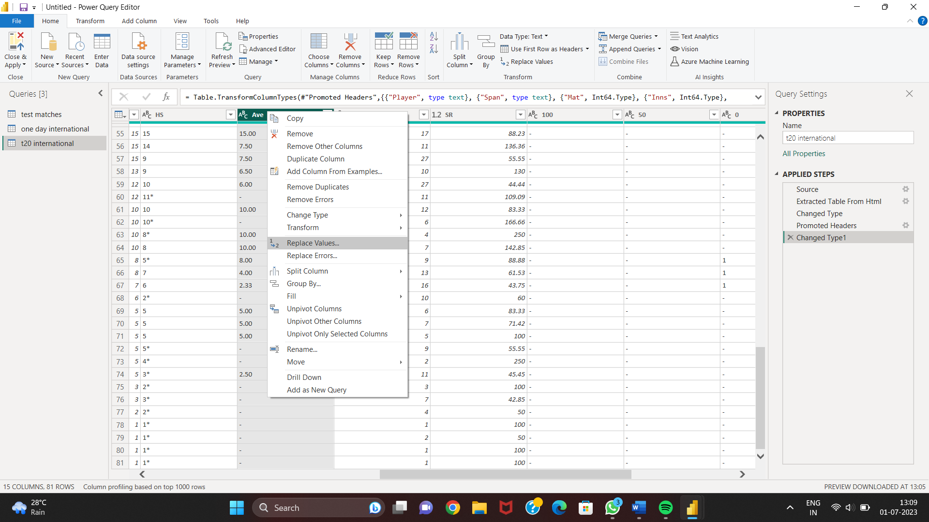
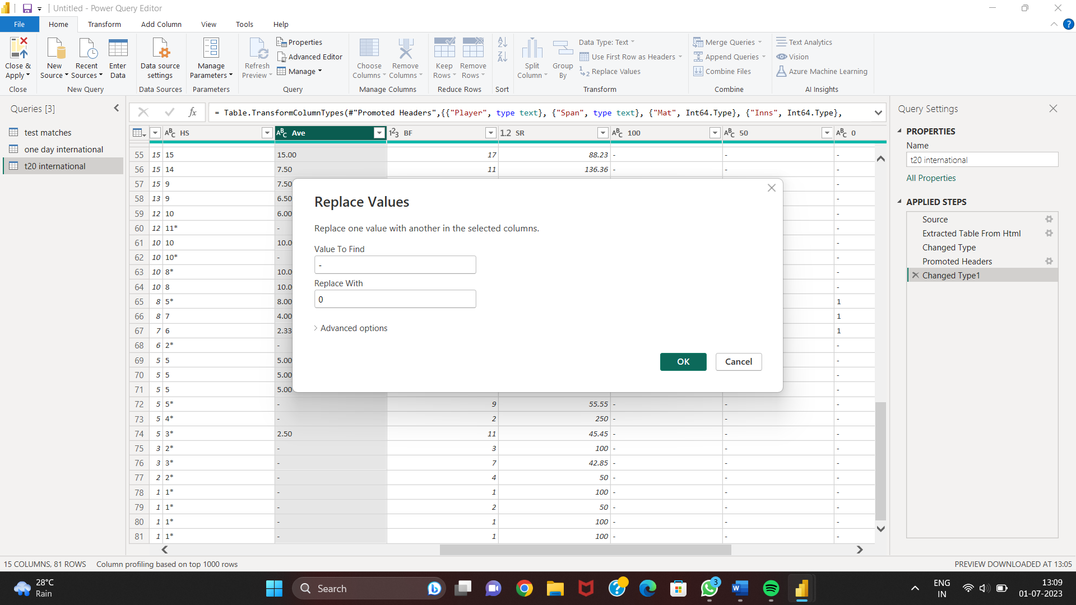
2) Relacing values – with 0.

Slide 22
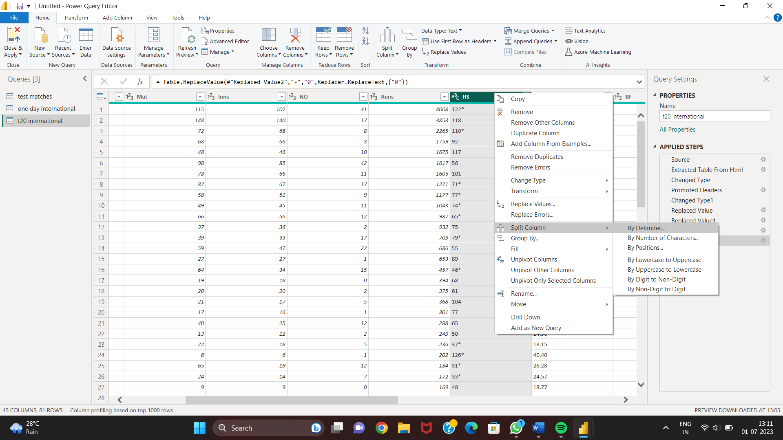
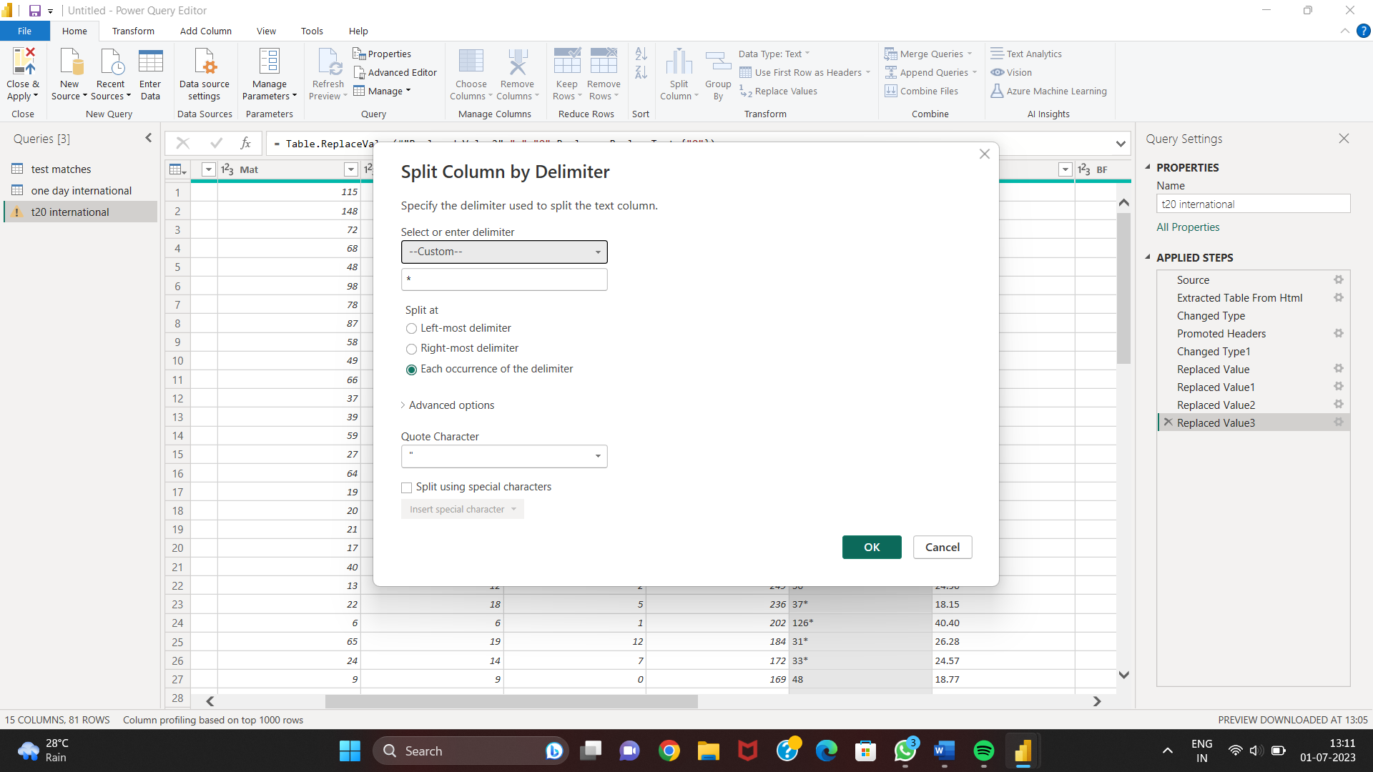
3) Split the * symbol from column.

Slide 23
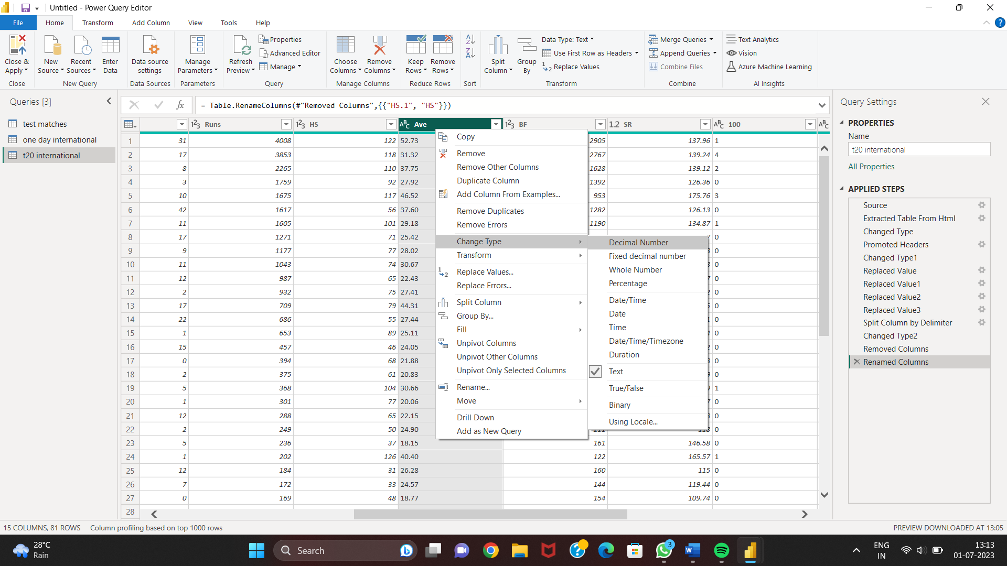
4) Change the data type.

Slide 24
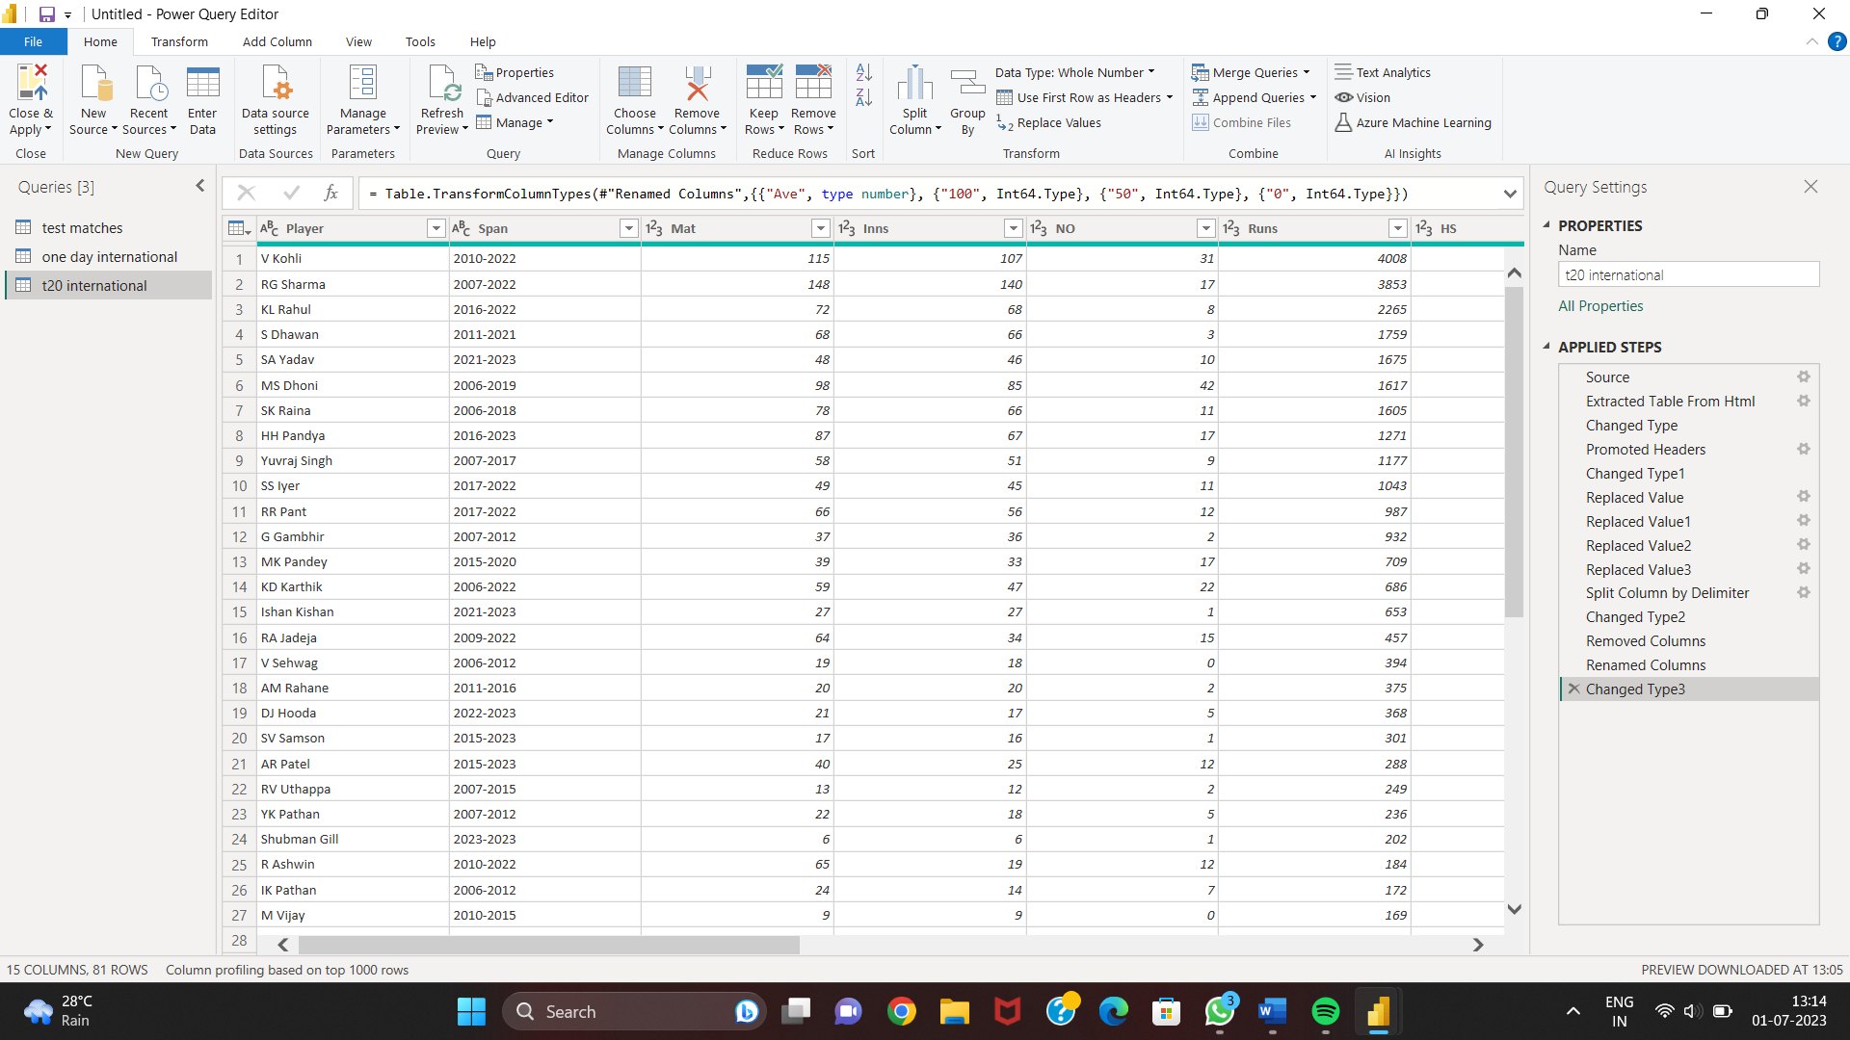
5) Cleaned data.

Slide 25
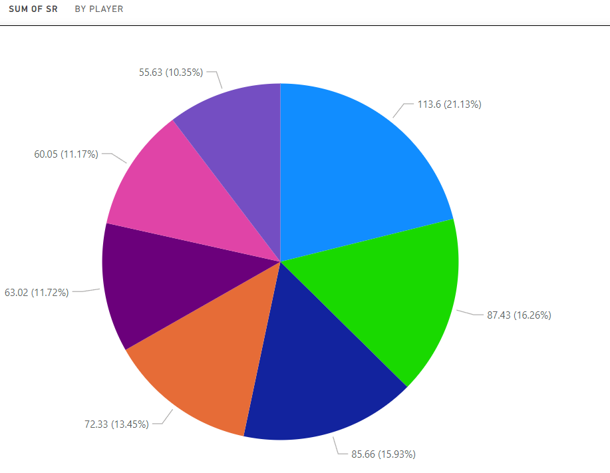
In Power BI, a pie chart is a visualization that is used to represent data as a circular graph, divided into slices to illustrate the proportions of different categories or values within a whole. Pie charts are commonly used to display the relative distribution or composition of data points.
Pie Chart

Slide 26
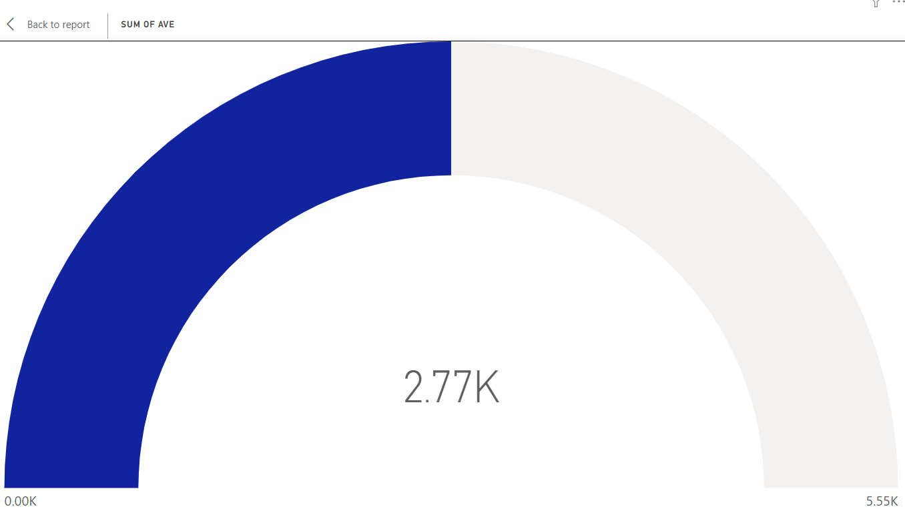
Gauge Chart
In Power BI, a gauge chart is a visualization that resembles a speedometer or dial gauge. It is used to display a single value within a given range and provide a visual representation of how that value compares to predefined thresholds or targets. Gauge charts are commonly used to convey performance indicators, progress towards goals, or to represent KPIs (Key Performance Indicators).

Slide 27
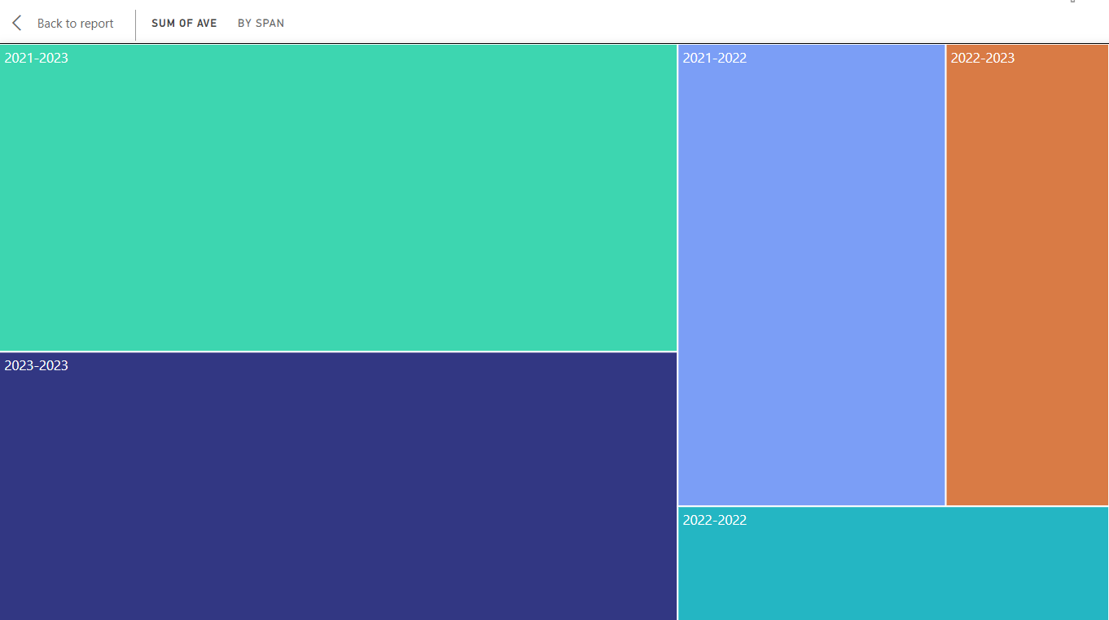
Tree Map Chart
A tree map is a visualization that displays hierarchical data as a set of nested rectangles, with each rectangle representing a category or subgroup. The size of each rectangle represents a quantitative value, allowing users to compare the proportions and relative sizes of different categories within a hierarchy.

Slide 28
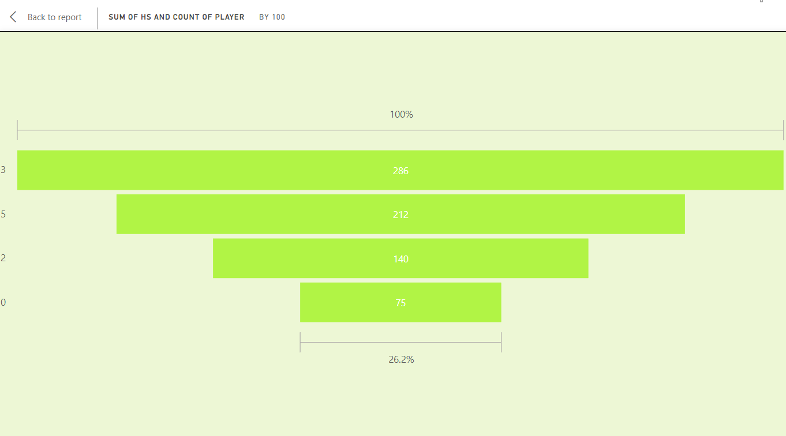
Funnel Chart
A funnel chart is a visualization that represents a series of stages or steps in a process, showing the progressive reduction or conversion of data or values as they move through the stages. Funnel charts are commonly used to analyze and visualize the flow or conversion rates of a process, such as sales pipelines, marketing campaigns, or customer journeys.

Slide 29
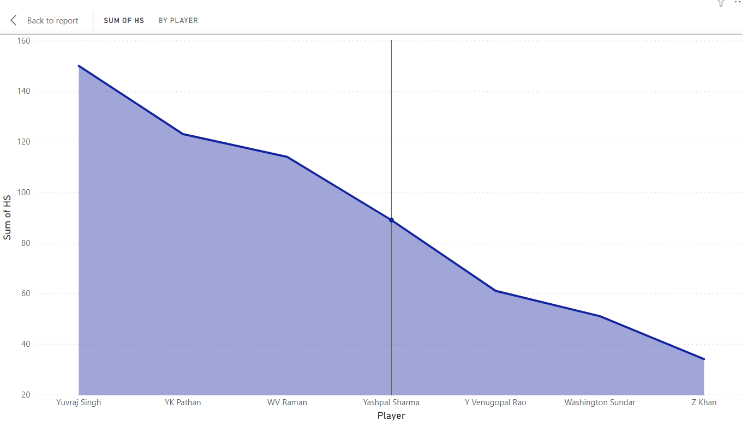
Area Chart
An area chart is a visualization that displays the quantitative data as an area between the x-axis and the line that represents the data values. Area charts are commonly used for the following purposes:1) Trend Analysis.
2) Comparison of Multiple Data Series.
3) Data Comparison with Baselines.

Slide 30
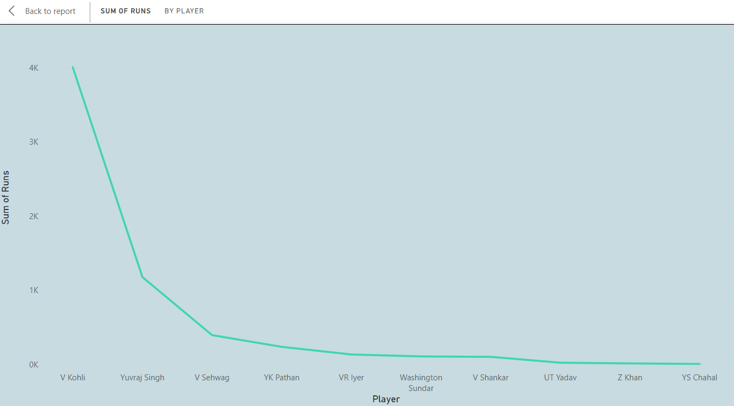
Line charts are used to track changes over time. They are used over column charts when there are multiple groups you want to spot trends for or tracking small changes over time.
Line Chart

Slide 31
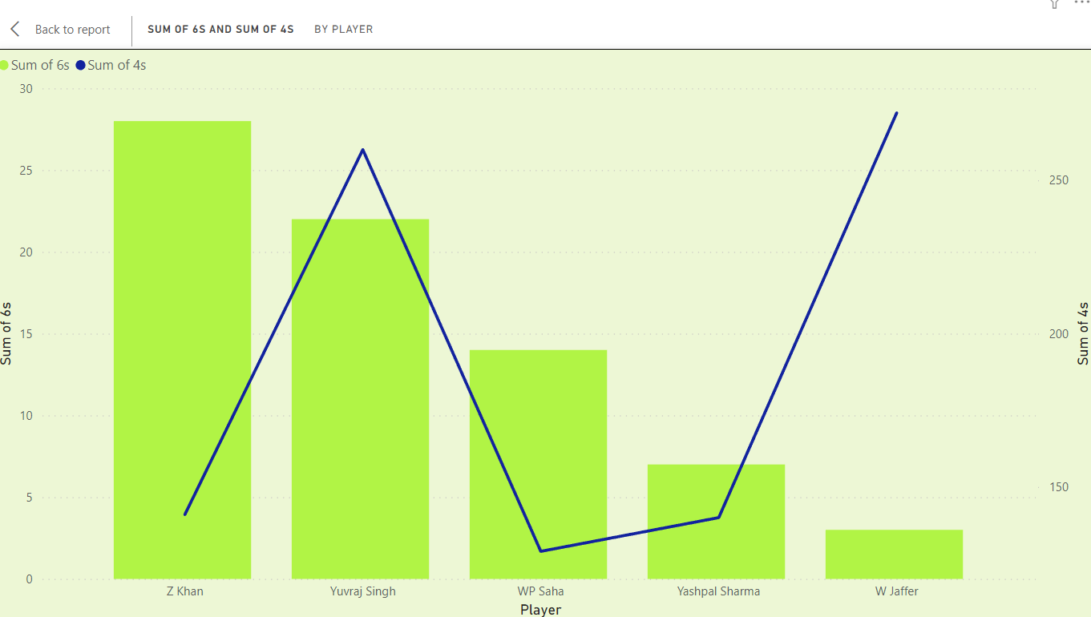
Line and Stacked Column Chart
In Power BI, a combination of line and stacked column chart is a visualization that combines the features of both line charts and stacked column charts. It allows for the simultaneous display of data trends using lines and the comparison of data categories using stacked columns. The line and stacked column chart is a powerful visualization for conveying a comprehensive view of both total values and trends within categories. It allows users to analyze the overall distribution, individual components, and trends simultaneously.

Slide 32
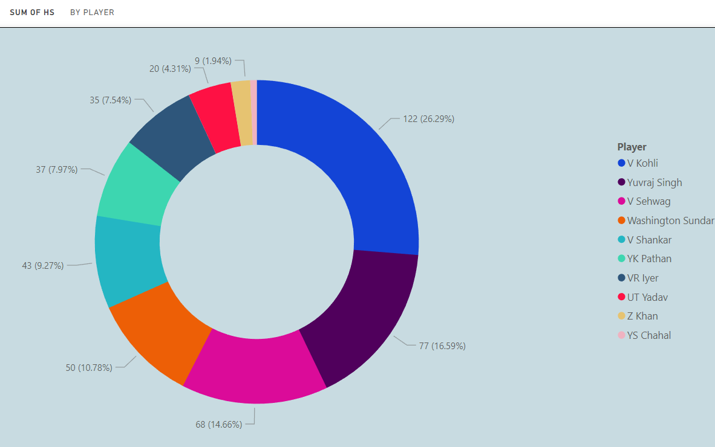
Donut Chart
A donut chart is similar to a pie chart in that it shows the relationship of parts to a whole. The only difference is that the center is blank and allows space for a label or icon.

Slide 33
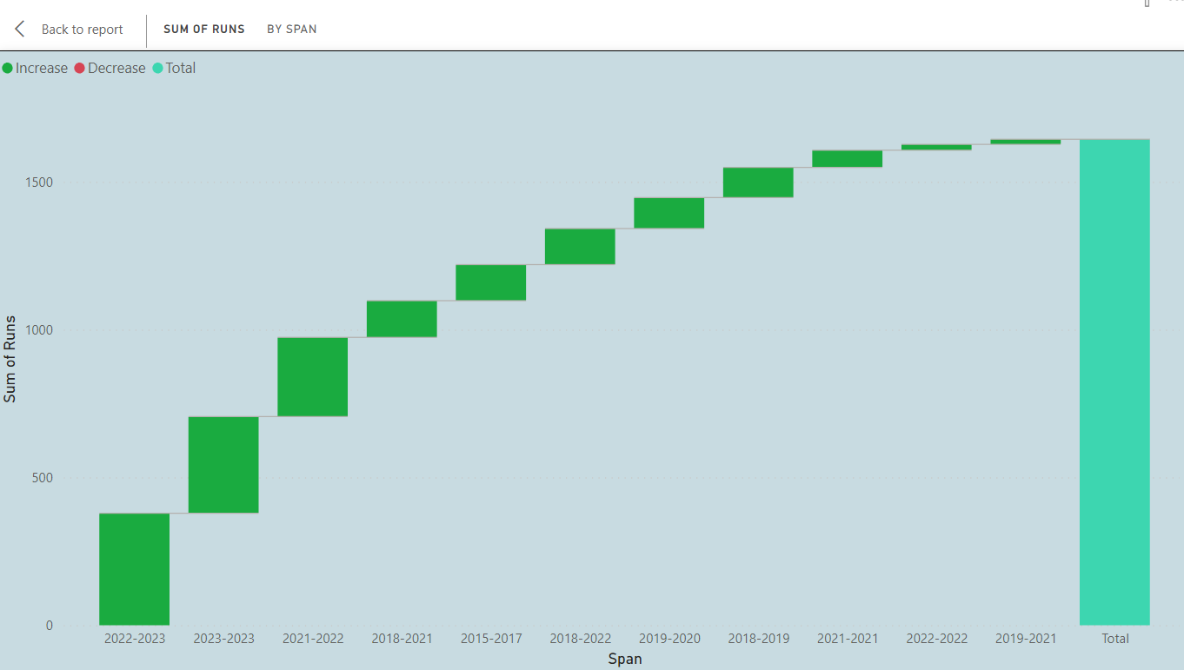
Waterfall Chart
Waterfall charts show a running total as Power BI adds and subtracts values. These charts are useful for understanding how an initial value (like net income) is affected by a series of positive and negative changes. The columns are color coded so you can quickly notice increases and decreases.

Slide 34
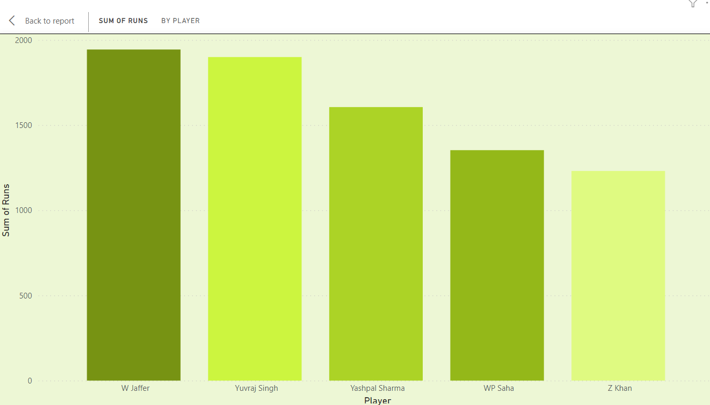
Stacked Column Chart
They are useful for comparing the composition of different categories within a larger category or for tracking changes over time. When using stacked column charts in Power BI, it's important to ensure that the data is suitable for this type of visualization and that the chart is properly labeled and formatted for clarity. Consider the number of categories and sub-categories, the readability of the labels, and the appropriate use of colors to enhance the visual presentation of the data.

Slide 35
Thank You!!

